Slide 1
Group Policy

Slide 2
Topics

Slide 3
What is Group Policy
Group Policy Objects are containers within Active Directory that contain rules or policies
GPO rules can apply to
  Users
  Computers

Slide 4
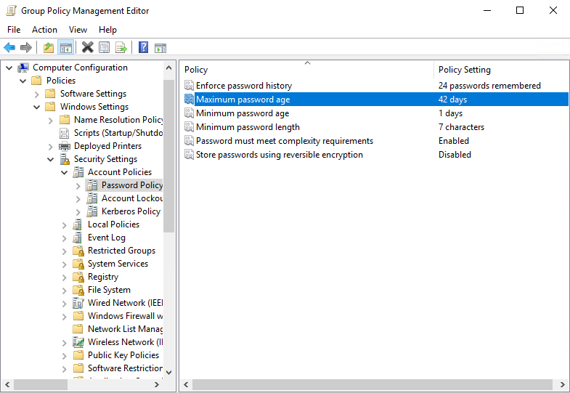
Examples
Notes:
Picture shows the Group Policy Management Editor. Specifically the password policy found under Computer Configuration > Windows Settings > Security Settings > Account Policy > Password Policy
Currently in the image the maximum password age is 42 days

Slide 5
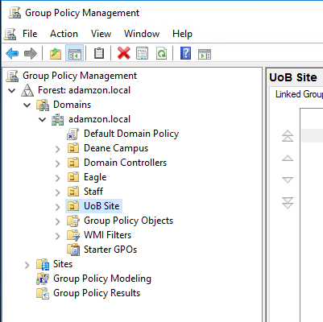
Group Policy Management Tool
Found on the start menu under "Windows Administrative Tools"
Shows a tree view of your Forest, trees and domains together with the organisational units they contain

Slide 6
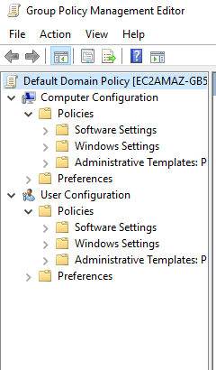
Broad Areas
Policies split into
  Computer Configuration
  User Configuration
Each of those is further split into
  Software Settings
  Windows Settings
  Administrative Templates

Slide 7
Placement of policy
What if… we say all students shall have an M-Drive quota of 5GB but computing students who need to store large Virtual Machine files need more space than the default quota so they get 20GB.
How do we resolve this in Group Policy?

Slide 8
Precedence
Local Policies are applied first
Site Policies are next
Domain Policies are third
OU Policies are fourth
Where OUs are nested, the outer policy applied before the more specific policy
In general wider catch-all policies can be overridden by more specific policies closer to the computer or user

Slide 9
Application Order
Policies applied to computers are applied when the computer boots
  Possible to force them to be re-checked but normally a change to computer policy does not get applied until the next reboot
Policies applied to users are applied during the login process
  Again can be forced to re-apply, otherwise remain until next login
Policies that are applied last override earlier policies

Slide 10
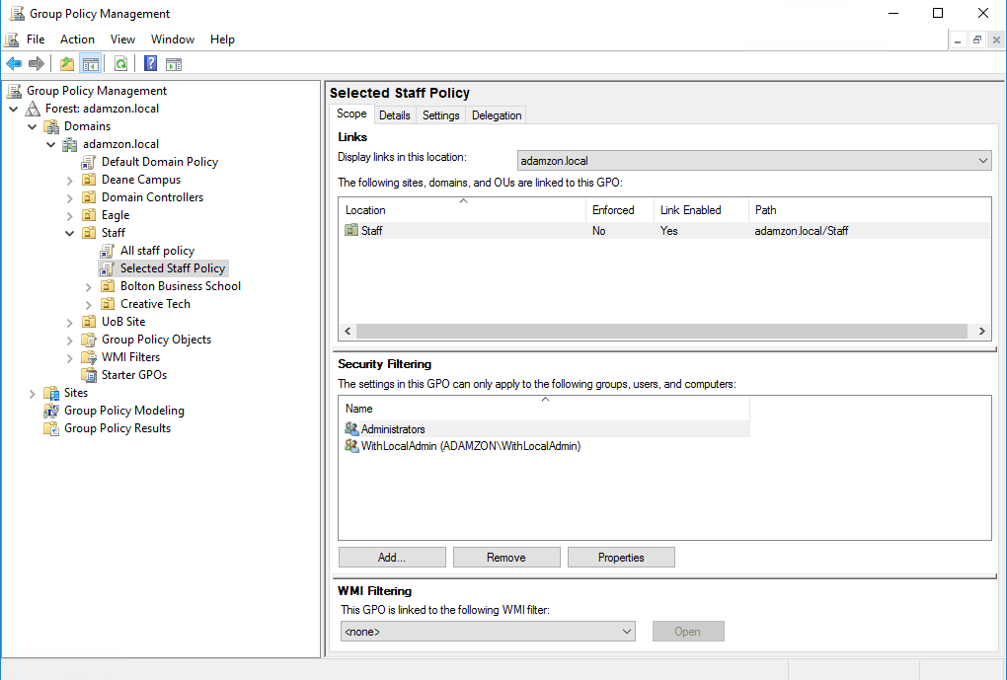
Filters
Normal to use OUs as containers for policies
Sometimes need a policy to apply to a specific sub-group
Can have multiple policies applied to an OU
Security Filtering allows us to specify individual users or groups that a GPO can apply to (much like ACLs on File System Objects)
Able to add users to a group so that a policy will apply to them permanently or on a short term basis

Slide 11
Blocking
High level GPOs can be countermanded by a lower level GPO with a different setting for a property.
Alternatively can select an OU and choose to Block Inheritance on the context menu (right-click)
Prevents ALL higher level GPOs from applying to the particular OU
Put in place different rules for the protected area
More efficient to do this than process a set of rules and then process a second contradictory set.

Slide 12
Enforcement
It may be the case that a particular GPO should always be applied and never blocked.
GPOs can have the "Enforce" property activated from their context menu
Settings in a policy that is enforced are always applied
If a policy is enforced, its settings are NOT overwritten by later policies
Enforcement overrules Blocking

